Slide 1
Phonics Workshop Friday 16th December 2016

Slide 2
What is Phonics?
It is the relationship between letters and sounds and two sills of blending and segmentation – putting the sounds together and breaking them up again which leads to reading and writing.
The children will learn a range of sounds. There are 26 letters in the alphabet but 44 sounds in the English Language (phonemes)
Letter sounds can be represented in lots of different ways
e.g. the basic single letter sounds phonemes of a, b, c, d, e
digraph sounds – these have 2 letters that only make one
sound
– sh, th, ng, oa, ow - some are very tricky
– e.g. th, ow
trigraph sounds – these have 3 letters that only make one
sound - igh, ear, air

Slide 3
The learning of sounds Process
Listening to sounds around us
Being able to hear initial sounds in and other sounds in words
Being able to break up and put together sounds (blend and segment)
Reading and Writing

Slide 4
So where do we start?

Slide 5
Where do we start? – Listening Games
Children need to have LOTS of opportunities to listen.
If children are not able to listen, they will be unable to hear any sounds/phonemes.
How can we help children to listen?
Listening walks - listening to lots of different sounds around us – cars
driving, people talking, birds singing, dogs barking, aeroplanes flying
Singing nursery rhymes/familiar songs together – singing in a loud voice,
singing in a quiet voice
Exploring musical instruments with your child – playing musical
instruments
Making funny noises with our mouths – listening to sounds and trying to
make these – especially if your child finds it tricky to pronounce certain
sounds.

Slide 6
What do we do next? – Hearing initial and other sounds in words
Once children are able to listen, children then need lots of opportunities to hear and be exposed to sounds/phonemes
Children will first need to be able to hear the initial sounds in words. Playing the game of I Spy will help with this e.g. I spy with my little eye something beginning with a ‘b’ sound – b,b,b, bus.
Once children can hear the initial sound in words, we must then help them to hear the other sounds in words.
Playing action games – can you stand on one l-e-g, can you h-o-p,
can you t-ur-n, can you t-a-p your
shoulders, can you b-ee-p your nose.
Playing phonic games – Silly Soup, What’s in the box, Mrs Browning’s Bag

Slide 7
Children initially need lots of practise of being able to hear the initial sounds in words. If this is not practised and modelled to them, children will be unable to hear these.

Slide 8
Oral Blending and Segmenting
Once children are able to hear sounds in words, they can then secure the skills of blending and segmenting.
Blending – To be able to put together/merge sounds phonemes together to be able to read words.
Segmenting – To be able to break up and hear individual sounds in words.
It is essential that children start by learning the letter sounds.
Children should NOT start with learning the letter names as this carries no mearning for them in reading.
E.g. c-a-t = cat and CAT

Slide 9
Blending
Blending is the process of merging letter sounds together to read a word e.g. d-o-g, c-a-t, m-a-p
Segmenting
Segmenting is the process by which children hear the individual sounds in words
e.g. c-a-t – 3 letters, 3 sounds
c-l-a-p – 4 letters, 4 sounds
ch-i-n – 4 letters, 3 sounds
th-i-ck – 5 letters, 3 sounds

Slide 10
Activity:
Can you work out how may sounds are in the following words:
hat, fox, ship, strong, zoom, chimp

Slide 11
How can I practise blending and segmenting at home?
Silly Soup
What’s in the box
Mrs Browning’s Bag

Slide 12
Prior to being able to write, children need to develop their fine motor and gross motor skills.
Fine motor skills mean the development of the muscles in children’s fingers and hands.
Gross motor skills mean the development of the muscles in their core, shoulders and arms.
If children have not developed these skills, they will find writing exceedingly challenging.

Slide 13
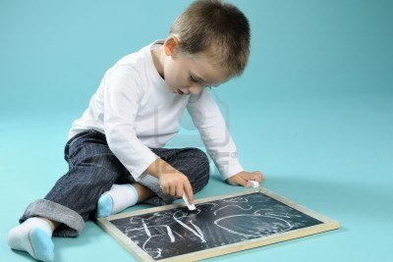
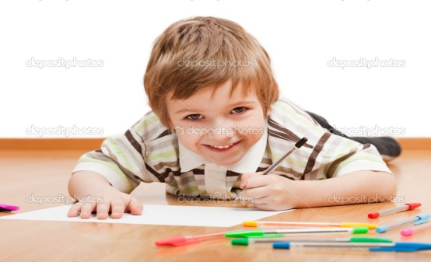
Writing
The process of writing is one of the hardest things to do – especially when you are 4 years old.
Activity
Why is this such a hard activity for our children? Especially our boys?
This is why writing needs to be done in lots of different ways

Slide 14
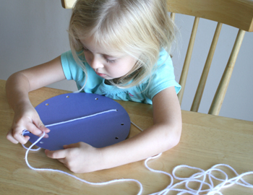
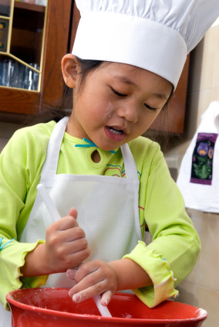
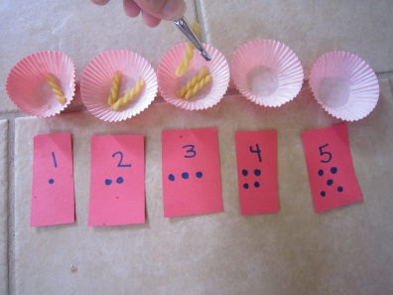
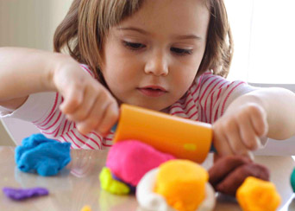
How can I help my child?
Lacing
Threading
Tweezer activities
Cutting
Cooking – cutting, mixing, grating
Pouring
Playdough
Chalking
Painting and mark making in sand, flour
Messy Play - Cornflour, Toothpaste, Shaving Foam, Gel
Rice pictures and pasta pictures

Slide 15
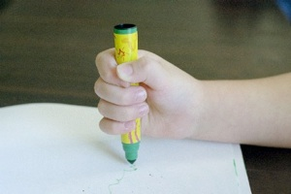
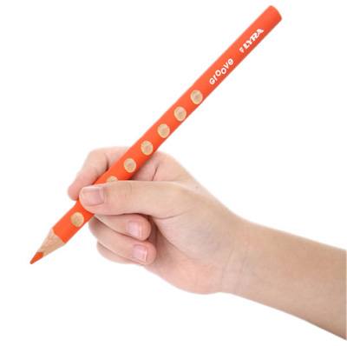
Pencil Grip
Palmar Grasp
Tripod Grip
Pincer Grip

Slide 16
Learning the Letter Sounds
After all this initial groundwork has been done, the children will now be ready to learn their letter sounds.
The following phonemes are taught initially:
s, a, t, p, i, n, m, d, g, o, c, k, e, u, r, h, b, f, l
The children are also taught the letter formation for each of the sounds according to the Read Write Inc Programme as part of their handwriting.
Every Phoneme is formed in a certain way and these must be formed in the correct way.
The children have been learning sayings that go with each phoneme to help form these correctly.
PLEASE REMEMBER YOUR CHILD SHOULD NOT BE USING CAPITAL LETTERS IN WRITING!

Slide 17
Reading
At this point the process of reading and writing can begin with decodable words.
Decodable words are words that can be sounded out.
However there are also words that are non-decodable. These are called tricky words.

Slide 18
Tricky Words
Tricky words are also taught to the children.
Tricky words are words that you cannot sound out.
We explain to the children that these are words we need to take a picture of with You need to take a picture of them with your brain box and remember what these words look like.
Examples are: the, to, I, go
These must be taught as well for reading.

Slide 19
Sound Buttons
Children are taught to read words using sounds buttons
E.g. cat dog
... ...

Slide 20
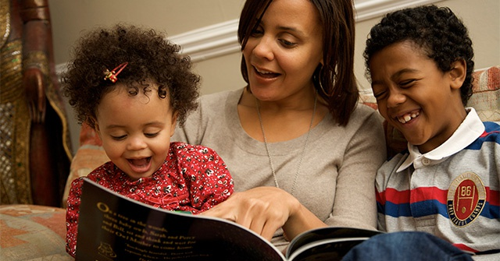
Reading
To read, a child must connect two processes:
The skill of blending + phoneme recognition = reading
d-o-g = dog
Once the children connect these processes, the children will be able to read simple words.
Once the children can read simple words, they will then be able to read simple captions e.g. pat the dog.

Slide 21
Writing
To write, a child must connect two processes:
The skill of segmentation + phoneme recognition =
Writing
Once the children will be able to read and write simple words e.g. pin, sad, tin, mad, hat, cap
Once they can write simple words, they then need to be challenged to write simple captions.

Slide 22
Digraphs and Trigraphs
Once the children have been taught their main phonemes, the children will then be taught the digraph and trigraph sounds.
A digraph sound contains two letters but it only makes one sound
Examples of digraphs are:
ch in chip, chin oo in book, zoom
sh in shop, shed ar in park, shark
th in this, that or in fork, cork
ng in sing, bang ur in curl, hurt
ai in rain, sail ow in down, towel
ee in feet, meet oi in coin, soil
oa in boat, float er in hammer, ladder

Slide 23
A trigraph sound contains three letters but it only makes one sound
Examples of trigraphs are:
igh in light, fight, tonight
ear in near, tear
air in hair, pair
ure in pure, cure

Slide 24
The children initially find using the digraph and trigraph sounds challenging.
Sound buttons can really help the children to understand these.
For single phonemes, children are taught to use a dot under the phonemes
leg cup fog pet
... ... ... ...
For digraphs, children are taught to use a line under the digraph
shop night park soap
_ .. .__. . _ . ._ .

Slide 25
Children are given opportunities to practise reading and writing words containing these sounds.

Slide 26
Reading
To develop the children's reading skills, the children will have guided reading sessions at school. We are aiming for a minimum of 2 times a week.
The children will have the opportunity to develop their reading skills through the application of their phonics knowledge.
The children will have the opportunity to develop new vocabulary through the application of their phonics knowledge.
The children will have the opportunity to develop their understanding of what they are reading.

Slide 27
Writing - Do’s
Children will have the opportunity to explore writing in fun and creative ways
Children can do the following:
write shopping lists for parents
write cards for family members
write letters to favourite characters
write recipes for things cooked
write labels for models they might make

Slide 28
Let children write things as they hear them
e.g. sugar – a child might write shoogar
ladybird – a child might write ladeeburd
It is all about the application of what they have learnt

Slide 29
Do’s
Encourage your child to use their sounds to label pictures they draw – praise them for everything they do. Remember they are 4 years old – it does not need to be perfect!!!!!
Give your child lots of praise for any attempts at writing – even if it is a scribble
Ask your child to help them write you a shopping list
Practice writing cards to family and friends
Write recipes whilst cooking with your child
Encourage your child to read signs on shops, vehicles, buildings, houses

Slide 30
Thank you for coming to our phonics workshop. We hope you have found it helpful and that you will take away lots of ideas of ways to support your child on their learning journey.

Slide 31
Any Questions?

Slide 32
Thank you for coming

